Slide 1



Probability Distribution

Slide 2
Uniform Discrete Distribution

Slide 3
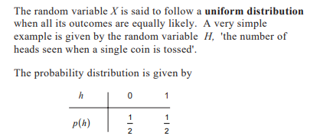

Slide 4
Example:
The event of rolling a die can be represented by a discrete random variable with the probability distribution being such that each event has a probability of 1/6

Slide 5
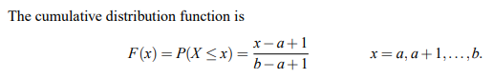

Slide 6
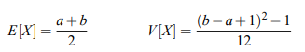
Expectation and Variance of uniform Discrete Distribution

Slide 7
Bernoulli Distribution
Bernoulli trial — a random experiment that has only two outcomes (usually called a “Success” or a “Failure”).
Getting a heads.
Getting a six on dice.
Getting two heads when we toss two coin simultaneously.

Slide 8
In an experiment whose outcome can be classified as either a success or failure.
Let (X=1) if the outcome is success and (X = 0) if it is a failure,
The probability mass function is given by
P(0) = P(X = 0) = 1-p
P(1) = P(X = 1) = p , where p is the probability of success.
X is Bernoulli random variable.

Slide 9
Example : A basketball player can shoot a ball into the basket with a probability of 0.6. What is the probability that he misses the shot?

Slide 10
Expectation of Bernoulli Distribution
P(X = 1) = p
P(X = 0) = 1-p
E[X] = P(X = 1) . 1 + P(X = 0) . 0
E[X] = p . 1 + (1-p) . 0
E[X] = p
Thus, the mean or expected value of a Bernoulli distribution is given by E[X] = p.

Slide 11
Variance of Discrete random variables
The variance can be defined as the difference of the mean of X² and the square of the mean of X.
Mathematically this statement can be written as follows:
Var[X] = E[X²] - (E[X])²
Var[X] = p - p²
= p(1 - p)

Slide 12
GATE CS 2011
If the difference between expectation of the square of a random variable (E[X²]) and the square of the expectation of the random variable (E[X])² is denoted by R, then? (A) R = 0 (B) R < 0 (C) R >= 0 (D) R > 0
Answer: (C)

Slide 13
Geometric Distribution
The geometric distribution is a probability distribution that models the number of trials required to achieve the first success in a sequence of independent Bernoulli trials, where each trial has a constant probability of success.

Slide 14
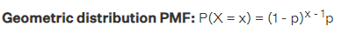

Slide 15
Geometric Distribution Example
Suppose a dice is repeatedly rolled until "3" is obtained.

Slide 16
The probability of getting a ”head” in a single toss of a biased coin is 0.3. The coin is tossed repeatedly till a ”head” is obtained. If the tosses are independent, then the probability of getting ”head” for the first time in the fifth toss is _______.
0.072
0.72
0
1
Answer (a)

Slide 17
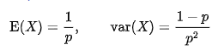
Expectation and Variance of Geometric Distribution

Slide 18
Binomial Distribution
Consider the scenario where we need to find the probability of the event of a even number showing up on die roll.

Slide 19
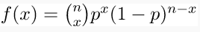
A random experiment consists of n Bernoulli trials such that
The trials are independent.
Each trial results in only two possible outcomes, labeled as “success” and “failure.”
The probability of a success in each trial, denoted as p, remains constant.
The random variable X that equals the number of trials that result in a success is a binomial random variable with parameters 0 < p < 1 and n = 1, 2, …. The probability mass function is given by-

Slide 20
Example
Suppose a biased coin comes up heads with probability 0.3 when tossed. The probability of seeing exactly 4 heads in 6 tosses is

Slide 21
Expectation and Variance of Binomial Distribution
E[X] = np
$$\left.V[X]=np(1−p\right)$$

Slide 22
GATE CS 2021
For a given biased coin, the probability that the outcome of a toss is a head is 0.4. This coin is tossed 1,000 times. Let X denote the random variable whose value is the number of times that head appeared in these 1,000 tosses. The standard deviation of X (rounded to 2 decimal place) is _________ . (A) 15.49 (B) 50 (C) 16 (D) 10
Answer: (A)

Slide 23
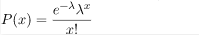
Poisson Distribution
Suppose an event can occur several times within a given unit of time. When the total number of occurrences of the event is unknown, we can think of it as a random variable. This random variable follows the Poisson Distribution.

Slide 24
Example- For the case of the thin copper wire, suppose that the number of flaws follows a Poisson distribution with a mean of 2.3 flaws per millimeter. Determine the probability of exactly two flaws in 2 millimeter of wire.

Slide 25
Mean, Variance and Standard Deviation –
Expectation[X] = $λ$
Var[X] = $λ$
Standard deviation [X] = $\sqrt{λ}$

Slide 26
GATE CS 2013
Suppose p is the number of cars per minute passing through a certain road junction between 5 PM and 6 PM, and p has a Poisson distribution with mean 3. What is the probability of observing fewer than 3 cars during any given minute in this interval? (A) 8 / (2e³) (B) 9 / (2e³) (C) 17 / (2e³) (D) 26 / (2e³)
Answer: (C)

Slide 27
GATE-CS-2017 (Set 2)
If a random variable X has a Poisson distribution with mean 5, then the expression E[(X + 2)²] equals _____.
Note: This question appeared as Numerical Answer Type. (A) 54 (B) 55 (C) 56 (D) 57
Answer: (A)

Slide 28
Exponential Distribution
Suppose we are posed with the question- How much time do we need to wait before a given event occurs? Since the time we need to wait is unknown, we can think of it as a Random Variable.

Slide 29
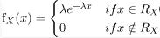
Exponential Distribution For a positive real number $λ$ the probability density function of a Exponentially distributed Random variable is given by-

Slide 30
Expectation, Variance and Standard deviation –

Slide 31
GATE CS 2021
The lifetime of a component of a certain type is a random variable whose probability density function is exponentially distributed with parameter 2. For a randomly picked component of this type, the probability that its lifetime exceeds the expected lifetime (rounded to 2 decimal places) is ____________. (A) 0.37 (B) 0.25 (C) 0.50 (D) 0.18
Answer: (A)

Slide 32
Uniform Distribution
The Uniform Distribution, also known as the Rectangular Distribution, is a type of Continuous Probability Distribution.

Slide 33
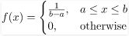
It has a Continuous Random Variable X restricted to a finite interval [a, b] and it’s probability function f(x) has a constant density over this interval. The Uniform probability distribution function is defined as-

Slide 34
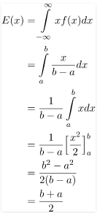
Expected or Mean Value – Using the basic definition of Expectation we get –

Slide 35
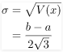
Variance- Using the formula for variance- V[X] = E[X²] – E[X]²
$$V(x)=\frac{{\left(b−a\right)}^{2}}{12}$$
Standard Deviation – By the basic definition of standard deviation,

Slide 36
Example – The current (in mA) measured in a piece of copper wire is known to follow a uniform distribution over the interval [0, 25]. Find the formula for the probability density function f(x) of the random variable X representing the current. Calculate the mean, variance, and standard deviation of the distribution and find the cumulative distribution function F(x)

Slide 37
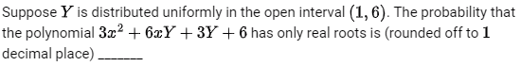
GATE CS 2019
Answer: 0.8
Notes:
B^2-4ac>=0

Slide 38
GATE CS 2014
Suppose you break a stick of unit length at a point chosen uniformly at random. Then the expected length of the shorter stick is ________ .
Answer: 0.25
Notes:
-10<Y<14 f(y) = 1/24

Slide 39
Normal Distribution
It is also known by other names such as- Gaussian Distribution, Bell shaped Distribution.

Slide 40
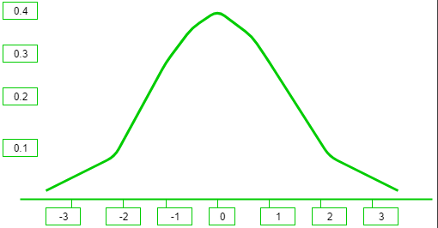
It can be observed from the above graph that the distribution is symmetric about its center, which is also the mean (0 in this case). This makes the probability of events at equal deviations from the mean, equally probable. The density is highly centered around the mean, which translates to lower probabilities for values away from the mean.

Slide 41
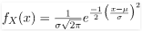

Probability Density Function –
The probability density function of the general normal distribution is given as-
In the above formula, all the symbols have their usual meanings, $σ$ is the Standard Deviation and $μ$ is the Mean.
The z-score is a measure of how many standard deviations away a data point is from the mean. Mathematically,

Slide 42
Standard Normal Distribution –
In the General Normal Distribution, if the Mean is set to 0 and the Standard Deviation is set to 1, then the corresponding distribution obtained is called the Standard Normal Distribution. The Probability Density function now becomes-

Slide 43
If X is a normal random variable with E(X)= $μ$ and V(X)= $σ$ , the random variable $Z=\frac{X−μ}{σ}$ is a normal random variable with E(Z)=0 and V(Z)=1. That is, Z is a standard normal random variable.

Slide 44
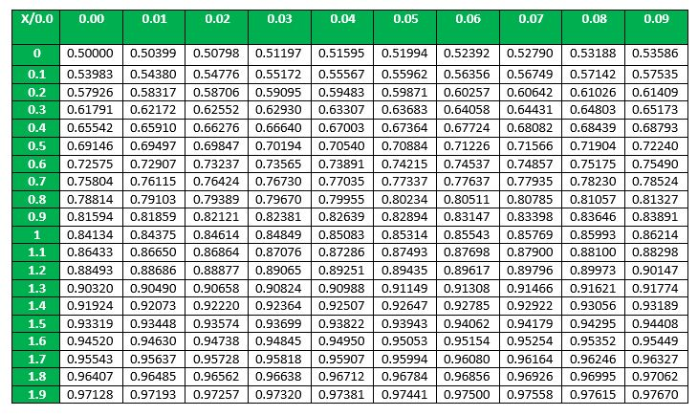

Slide 45
Example – Suppose that the current measurements in a strip of wire are assumed to follow a normal distribution with a mean of 10 milliamperes and a variance of four (milliamperes)² . What is the probability that a measurement exceeds 13 milliamperes?

Slide 46
Expected value , variance , standard deviation
The expected value of a standard normal random variable X is expected value = 0 variance = 1 standard deviation = 1

Slide 47
GATE CS 2008
Let X be a random variable following normal distribution with mean +1 and variance 4. Let Y be another normal variable with mean -1 and variance unknown If P(X <=-1) = P(Y >=2). the standard deviation of Y is (A) 3 (B) 2 (C) sqrt(2) (D) 1
Answer: (A)

Slide 48
GATE CS 2018
Two people, P and Q, decide to independently roll two identical dice, each with 6 faces, numbered 1 to 6. The person with the lower number wins, In case of a tie, they roll the dice repeatedly until there is no tie. Define a trial as a throw of the dice by P and Q. Assume that all 6 numbers on each dice are equi-probable and that all trials are independent. The probability (rounded to 3 decimal places) that one of them wins on the third trial is _______ .
Answer: 0.023

Slide 49

Thank you

